Slide 1
Nordic School of Hospitality & Innovation – Haaga-Helia, Tallinn
.

Slide 3
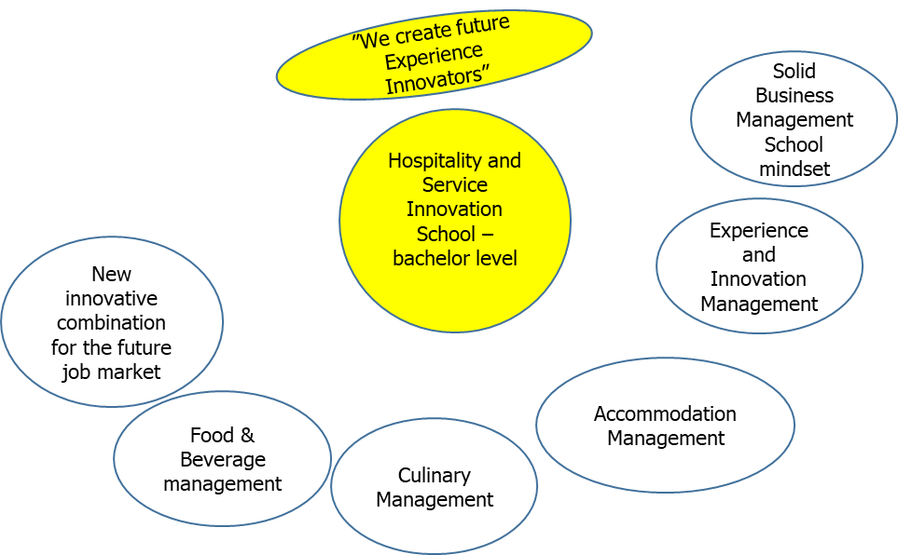
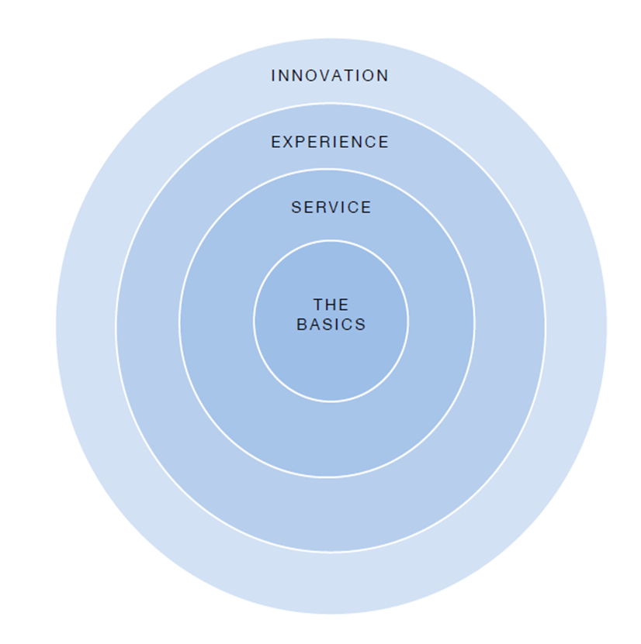
New School - Brand

Slide 4
New School - Process, Partners, Place
Last year Haaga-Helia founded in Estonia The Hospitality Innovation School Foundation as the owner of the new school - The Nordic School of Hospitality & Innovation - Haaga-Helia, Tallinn - to be opened soon
The school is a private university of applied sciences to be opened after the ongoing accreditation process in order to get the required permits and licences will be finalized
The school has designed and will deliver a diploma programme in strategic cooperation with Haaga-Helia UAS, Estonian Business School, Breda UAS (Netherlands), International University of Applied Sciences Bad Honnef (Germany) and Purdue University (USA)
The studies are planned to begin in January 2020

Slide 6
Application Process 3 in 1 …
… For
1) Founding The School,
2) Issuing The Education/Activity Licence
&
3) Grant Of Right
To Provide Instruction In Higher Eduction
In The Study Group
Based On The Curriculum To Be Opened

Slide 7
Initial Assessment of Study Programme Group
For initial assessment of a study programme group the EKKA assesses:
whether the qualification requirements of lecturers established by the educational institution and the qualifications of the lecturers involved in the studies are sufficient;
whether the resources required to conduct the studies are sufficient; and
whether the learning outcomes described are achievable with the study programme and whether the learning outcomes conform to the requirements of conducting studies at the level of higher education.

Slide 8
Accreditation Procedure
11-12/2018 application submitted to the Ministry
12/2018 EKKA (Eesti Kõrg- ja Kutsehariduse Kvaliteediagentuur|Estonian Quality Agency for Higher and Vocational Education) took over the process
EKKA hired experts to do the job (interviews & site visit on 14.03)
Based on Expert Report EKKA decision (partially conforms to requirements) made and passed on to the Ministry in April
Ministry prepares the decision to be made by the Minister in May
Minister passes on the (positive) decision to the State Cabinet in June
State Cabinet decision in July

Slide 9
New School – Curriculum 1
Diploma programme in International Hospitality and Service Excellence
3.5 years, 210 ECTS
Curriculum Mission - Developing motivated hospitality and service business leaders who engage in promoting a positive change whilst building on their vision. The program is committed to cultivating a sense of personal agency for students, contributing meaningfully to international hospitality in the 21st century.
The professional development targeted by the program unfolds as 3 major dimensions: Competence development, Personal development, Sense of resolution.
Focus Areas - Myself, Business, Guest-Host, Future
Core Values Of The Curriculum – Creativity, Reaching for the WOW, Community-ing, Building on Empathy, Doing Business

Slide 10
New School – Curriculum 2 Main Field Of Study Modules 105 ECTS
Major Module 1 Managing things, leading people
Responsible: Haaga-Helia, Ms Meri Vehkaperä
Major Module 2 Cracking the Numbers
Responsible: Haaga-Helia, Ms Marjaana Mäkelä, Bad Honnef, Mr. Florian Hummel
Major Module 3 Utilizing the Tools
Responsible: Haaga-Helia, Mr. Risto Karmavuo
Major Module 4 Mastering Distribution
Channels Responsible: Haaga-Helia Dr. Pasi Tuominen
Major Module 5 Designing the Future
Responsible: Breda, Mr. Geoff Marée
Major Module 6 Developing the Accommodation Business
Responsible: Haaga-Helia, Ms Nina Niemi
Major Module 7 Understanding your Customer
Responsible: Haaga-Helia, Dr. Teemu Moilanen

Slide 11
New School – Curriculum 3 Minor Field Of Study – Dimensions Of Hospitality And Service Professional 60 ECTS
Minor Module 8 Creating Culinary Experiences
Responsible: Haaga-Helia, Mr. Risto Karmavuo
Minor Module 9 Producing Business Value
Responsible: Haaga-Helia, Dr. Mário Passos Ascenção
Minor Module 10 Designing your own future
Responsible: Haaga-Helia, Ms Marjaana Mäkelä
Minor Module 11 Shaping the next Millennium
Responsible: Breda, Mr. Geoff Marée
Development / Research Project
Responsible: Haaga-Helia, Mr Mario Ascencao
Learning, Studying and Entrepreneurial Skills
Responsible: Haaga-Helia, Ms Marjaana Mäkelä
Internships
Responsible: Haaga-Helia, Ms Kristi Tarik

Slide 12
New School – Street Credibility
Among the 15 members of the School Board 3 industry representatives - Estonian Hotel & Restaurant Association, Estonian Travel & Tourism Association, Estonian Rural Tourism
Industry Advisory Board - an interlinking body between the School and the industry, community and society, which has an advisory function and includes notable hospitality and innovation industry, local community and wider society stakeholders - 9 members:
Estonian Restaurant Association/Tallinn Restaurant Week, Hilton Tallinn, Sokos Viru & Estoria, Unique Hotels, Hestia Hotel Group, White Guide/Flavours of Estonia, Estonian Spa Association/Tallink Hotels, 2 tbd

Slide 13
New School – Innovative Angle 1
Global cluster school – The studies at the School in question are delivered actually by 5 different schools from Estonia, Finland, Germany, Netherlands and the US
Blue ocean positioning vs. being the part of the existing red ocean
Market and expected intake is global, but the location local – the Tallinn-Helsinki twin capital city as the hub of the Baltic Sea Region
Not just another international ”hotel school”, but one with a strong twist on Innovation, Change Management and Creativity – revolutionary instead of looking back and preserving the present while being evolutionary
The hybrid school – part Hotel, part Innovation School aiming to become in the future a new model of higher hospitality education
Instead of placements and internships the Work & Study format is launched

Slide 14
New School – Innovative Angle 2
Competence-based and industry-related as much as possible meaning also, that the module based curriculum allows the industry to pop in in order to participate in the studies within certain modules and eventually causing a mix of students and industry representatives in the classrooms
Boutique-style and –size – maximum capacity expected to be 400 meaning very personal approach and attention to the students
The school being located at a hotel, means that the school is at the same time a hotel and the hotel is a school. Also – the school will include a separate, outsourced living unit for visiting scholars and students, possibly also used as part of the learning process run by students as a study hotel
School is partly physical, partly virtual – 1/3 of the studies planned to happen over internet
School will partner with surrounding hotels in the spirit of sharing economy, also for lean cost structure – the core campus or the HQ will contain the back-office and key facilities, but the ordinary classroom capacity will be relying on the use of the hotel conference facilities called the extended campus

Slide 15
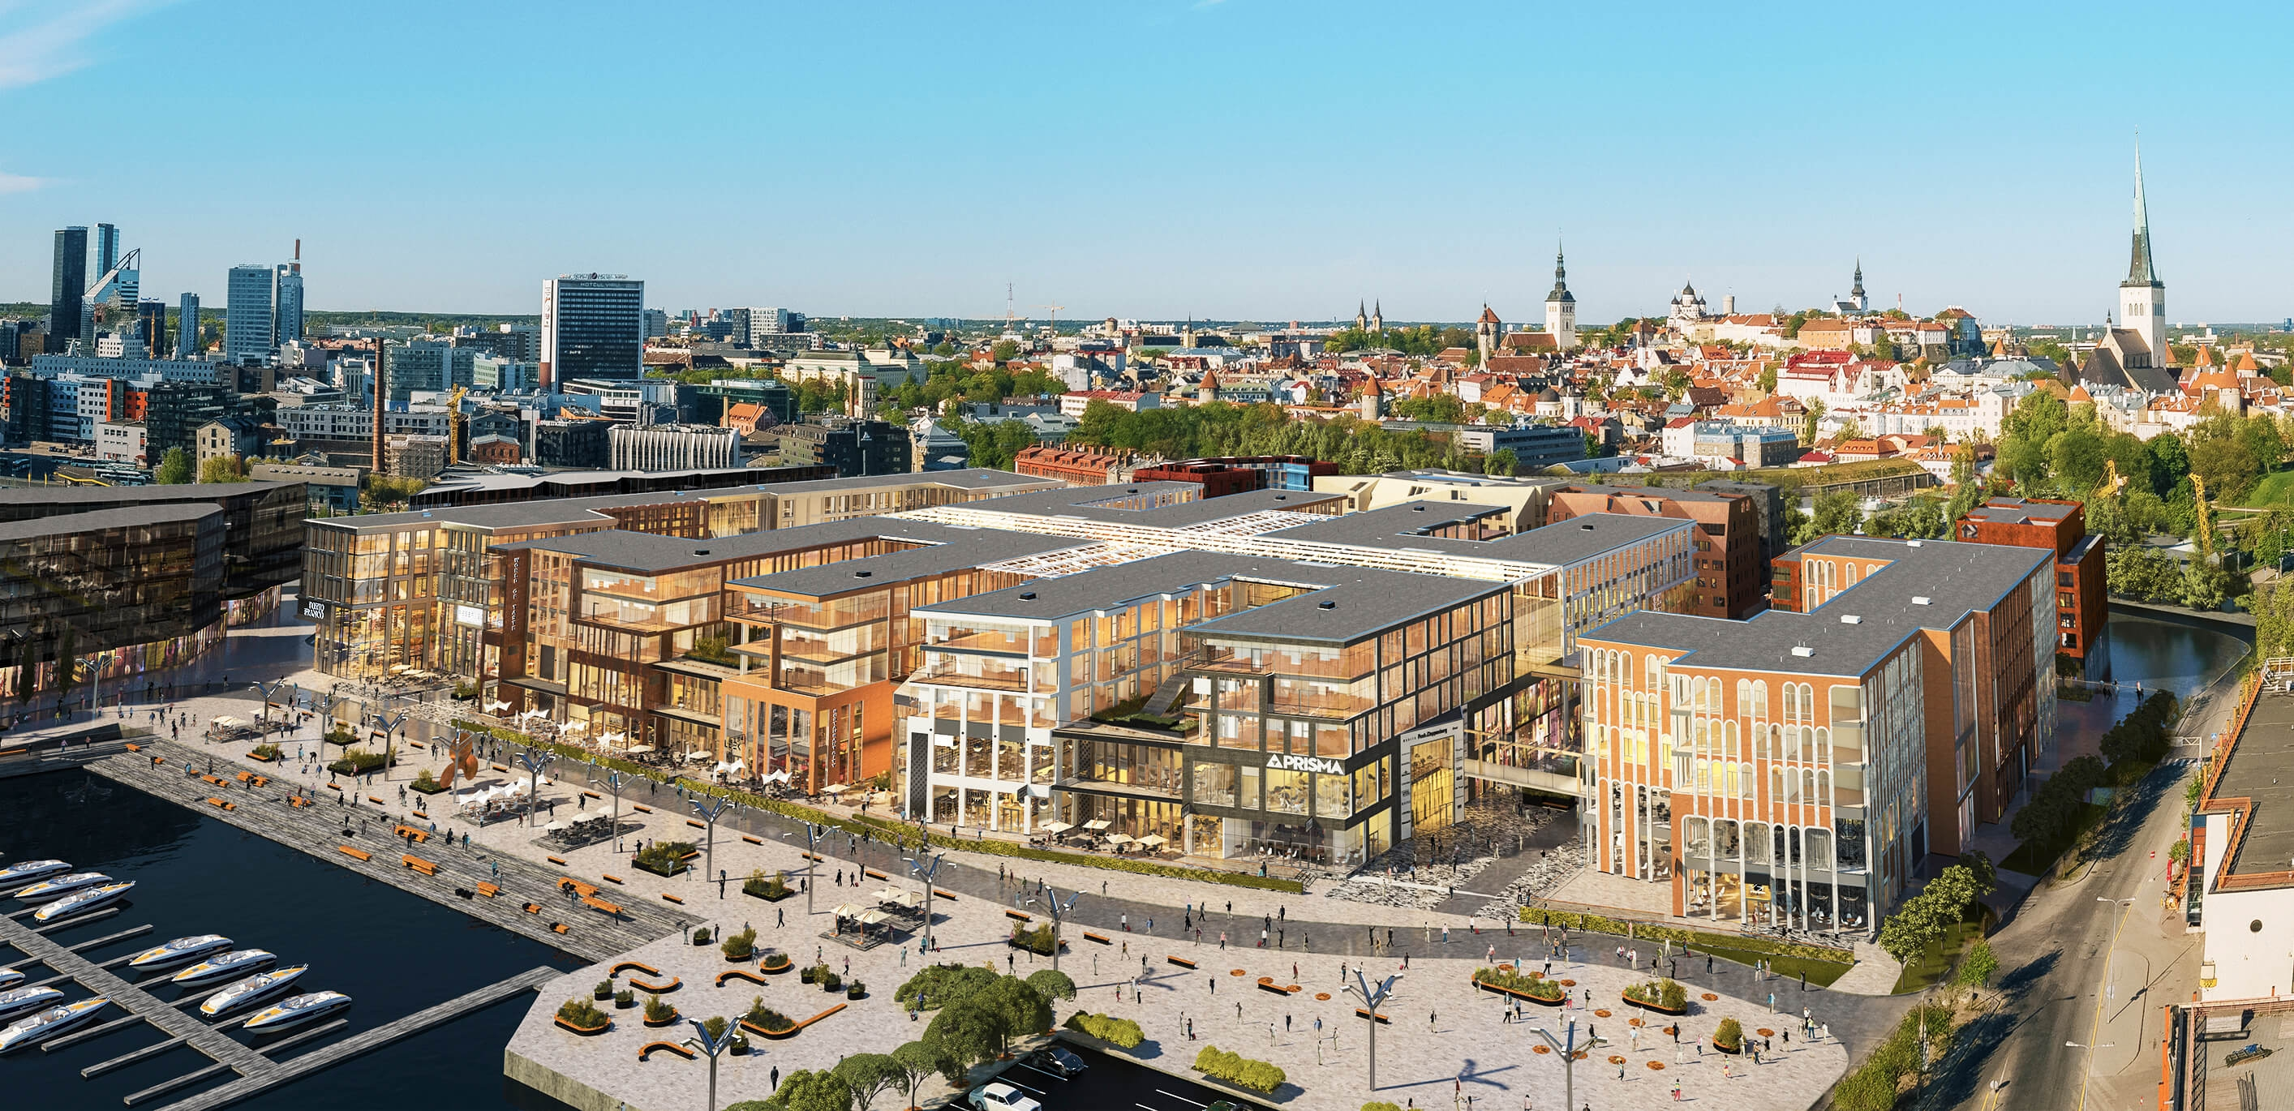
New School – Campus @ Porto Franco
.

Slide 16
New School - RDI & Industry Cooperation of School & Industry

